Slide 1
TOPIC A:
DATABASES
LESSON A-5
DATABASE TERMS & RELATIONSHIPS

Slide 2
AGENDA
Table
Record
Field
Primary Key
Secondary Key
Foreign Key
Candidate Key
Composite Primary Key
Join
One-to-One
One-to-Many
Many-to-Many
NOTE!
Have a way to take notes available for this lesson

Slide 3

THE WARM UP QUESTION
Identify the relationships likely present in the following conceptual schema
Teacher(TeacherID, Name)
Class(ClassID, TeacherID, Name, Time)
Student(StudentID, Name)

Slide 4
THE WARM UP ANSWER
One student takes many classes
One teacher teaches one or more classes
Multiple students take one class

Slide 5
TABLE
A Table is used to define entities in a database
What’s an entity?

Slide 6
RECORD
Each table will contain multiple records that are instances of an entity
A specific person, item, or place

Slide 7
FIELDS
Each table will also contain multiple fields that contain attributes about the entity
These can be anything about any entity, spanning anything from Name, to Birthday, to an Email Address
Each field has a specific data type that is enforced by the DBMS for that field

Slide 8
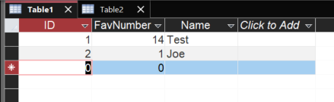
ALL OF EM

Slide 9

PRIMARY KEY
Primary Keys are an attribute used to uniquely identify records in a table
For each table, there will only be ONE record with any given value of a primary key
Often, this takes the role of a unique ID variable that represents nothing except being the primary key
This does not have to be the case however, and you can also use something like a Social Security Number, or something else that never repeats

Slide 10
FOREIGN KEY
Foreign Keys are used to identify elements from another table in your table
Foreign keys are always the primary key of another table
If you have a database with tables for planes and scheduled flights, you might see the scheduled flights table have a field for the PlaneID primary key from the plane table so you can know which plane a scheduled flight will use

Slide 11
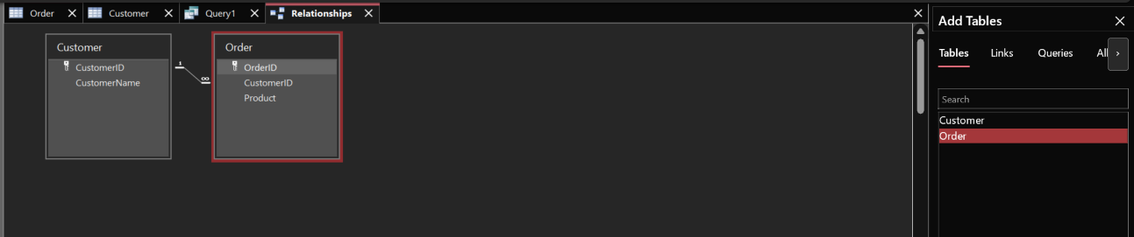
FOREIGN KEY
To set a foreign key in access, click a table, then the table tab in the header
Select Relationships, then click both tables from the right sidebar
Drag the primary key of the table onto the foreign key of the other and be sure to check “Reinforce referential integrity” in the setup popup

Slide 12
COMPOSITE KEY
Composite Keys are a type of primary key where two or more attributes together form a unique element
A common place we see these is in supporting tables
Well, what’s a supporting table?

Slide 13
SUPPORTING TABLES
Let’s return to our very common example of the customer, order, product system
When you make an order on Amazon, you aren’t limited to just one product, right?
But with the way we’d been looking at it, the order only has room for one ProductID

Slide 14
SUPPORTING TABLES
Customer(CustomerID, CustomerName, etc.)
Product(ProductID, ProductName, etc.)
Order(OrderID, CustomerID, ProductID, etc.)
The way that we get around this is by creating a supporting table that has a record for every item placed in an order
Let’s look at what this might look like

Slide 15
SUPPORTING TABLES
Customer(CustomerID, CustomerName, etc.)
Product(ProductID, ProductName, etc.)
Order(OrderID, CustomerID, etc.)
OrderLine(OrderID, ProductID, Quantity)
You’ll notice a few things
First, ProductID has moved to our OrderLine table, and OrderLine has an OrderID, but no OrderLineID as a primary key
So how do we uniquely identify it?

Slide 16
SUPPORTING TABLES
The combination of an order line’s OrderID and ProductID will always be unique
You cannot make two orders of the same item with the same OrderID
The only things that can share an OrderID are different products with different ProductIDs
Because there is no possible way to make two records that share an OrderID and ProductID, the combination of OrderID and ProductID IS a unique Primary Key in and of itself
One record in OrderLine represents one item in an order

Slide 17
CANDIDATE KEYS
A candidate key is any attribute that COULD be selected as the primary key
Recall that primary keys must have no records with repeating elements
A table for employees may have an EmployeeID and a SSN attribute which are both candidate keys

Slide 18
SECONDARY KEYS
A secondary key is a candidate key that isn’t selected as the primary key
This would be the SSN in that employee example from before

Slide 19
JOIN
A join is a function that can combine multiple tables based on a shared column
Tables may share a column if a column is used as a primary key

Slide 20
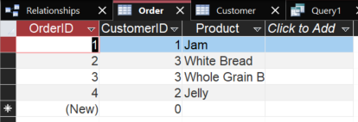
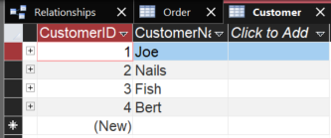
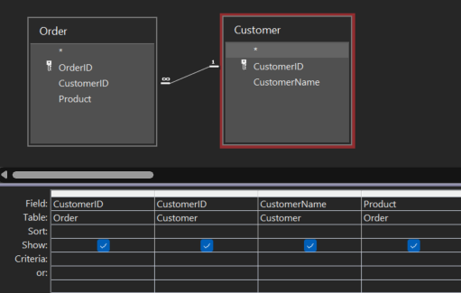
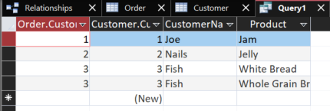
JOIN
A new record in a new joined table is created for each overlap

Slide 21

ONE TO ONE
One-to-one relationships represent one record in a table being associated with exactly one record in another table
For example, think of each country in a country table having one capital in a capital table
This can be redundant
Why not just put the capital as a field in the country table?

Slide 22

ONE TO MANY
One-to-many relationships represent one record in a table being associated with multiple records in another table
For example, one person may have multiple cars registered in their name
Or one school may have many students

Slide 23
MANY TO MANY
Many-to-many relationships appear when multiple records in a table may have a relationship with multiple records in another table
Many actors may act in many movies
The tricky thing is that the foreign key attribute in a table can only hold one reference
It is in these instances where we generally will need a supporting table

Slide 24
LAB
How well did you pay attention? It’s time for a Kahoot!
https://create.kahoot.it/details/ae3448d8-78c0-4c1b-984e-910911e20f4a

Slide 25

VOCAB TO REMEMBER
Table/Entity
Record
Attribute/Field
Primary Key
Foreign Key
Composite Key
Candidate Key
Secondary Key
Join
One-to-one relationship
One-to-Many relationship
Many-to-Many relationship
Supporting table

